Slide 1
What sells together?
Rushabh Jhaveri
RUID: 171008850

Slide 2
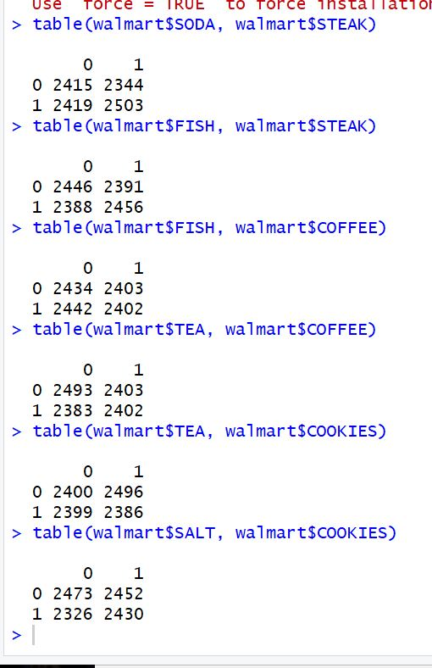
Making Tables
The first thing I did was to use the table() function with a few pairs of items to see if anything stood out.
Overall, the distribution over people who bought none (0,0), bought exactly one of the items (1,0) and (0,1), and bought both items in the pair (1,1) is fairly evenly spread out.
This made me think that maybe the distribution was random.

Slide 3
Further Investigations
To further investigate, I made tables of all possible combinations of items – a total of 42 items.
I then filtered these 42 tables and selected the pairs in which the (1,1) value was greater than the (0,0), (0,1), and (1,0) values, i.e., I selected those pairs which were more frequently bought together, than individually or not at all. Six such pairs were obtained – (Soda, Fish), (Soda, Cookies), (Steak, Soda), (Steak, Fish), (Fish, Cookies), and (Cookies, Soda).

Slide 4
Permutation test
Now that I had filtered out six distinct pairs, I performed the permutation test to see what results it gave.
I ran the permutation test on each pair three times – the first test was run for 100 iterations, the second test was for 1000 iterations, and the third test was run for 10000 iterations, to get a clear picture of whether the p value looked to be converging or diverging at a particular point.
I then chose the pairs that consistently converged at a p-value less than or equal to 0.05.

Slide 5
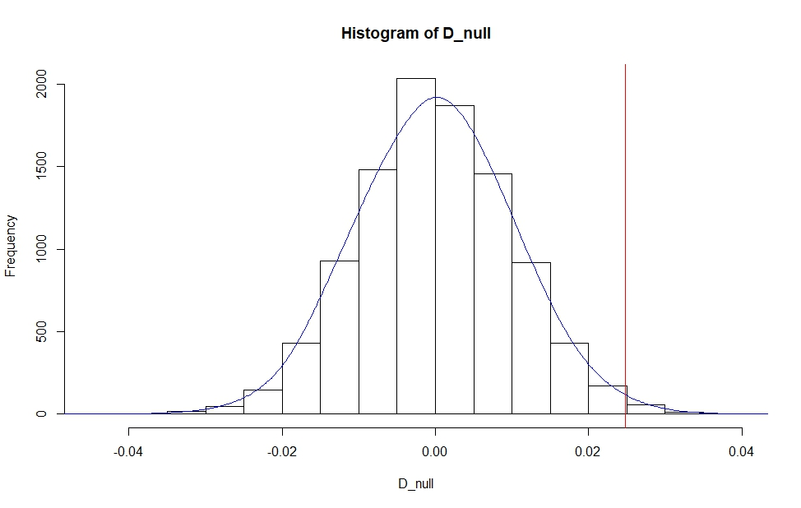
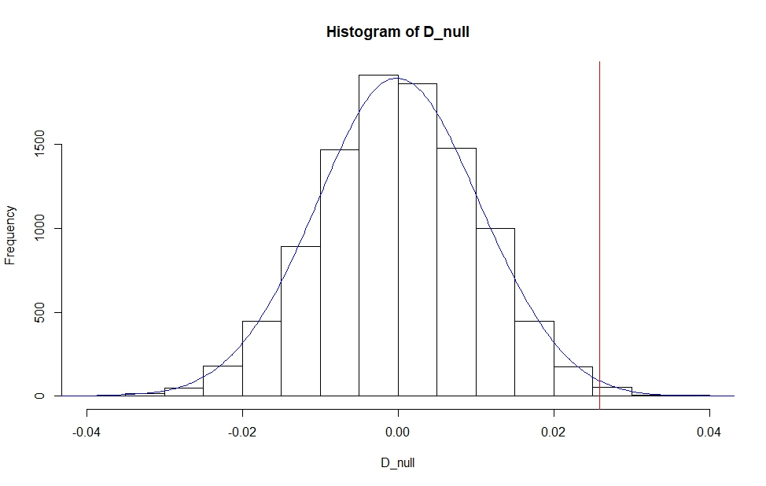
Results
Two pairs of items stood out and proved statistically to sell well together.
The first is (Soda, Fish) [top graph], which returned a p-value of 0.005 [1000 tests], and converged at 0.0048 [10,000 tests].
The second is (Cookies, Soda) [bottom graph], which returned a p-value of 0.006 [1000 tests] and converged at 0.0068 [10,000 tests].

Slide 6
An interesting Note
While the pairs that sell well together are have statistical backing, I noticed something interesting about the other pairs. It is very easy to get a “desirable” p-value for such a pair by manipulating the number of tests run. Sometimes, decreasing the number of tests, and sometimes increasing the number of tests results in obtaining a “desirable” p-value.
This has led me to a separate conjecture that perhaps the allocation of 1’s and 0’s are random, and that the fact that two products sell well depends on the number of tests run, and using the Bonferoni Coefficient [dividing the accepted p-value of 0.05 by N, the number of tests run], and that these “correlations” are only a matter of running the right number of tests.

